Slide 1


KETHOLESHIIDA… DIETHERIEKO
Ketholeshiida … Dietherieko kezhakesu, Kijiipete Krothoko Fort Worth, Texas
©2006 TBBMI
Designed by Dr. John Fryman, Texas, USA • BibleBasically.org
Taught by Dr. Rick Griffith, Singapore Bible College
All files in many languages for free download at BibleStudyDownloads.org
www.biblebasically.com
©2006 TBBMI

Slide 2

UKEPENUOPFII MHA RIIKRII ZOKECII PUO MOSA ZE RHIIKELIE
I
II
III
IV
V
VI
VII
VIII
IX
X
KETHOLESHII KEWEU NU TUOKEPRA
LESHIIDAU NUNU:
KEPHRII KEKHRUOHI #15
“MOSA GEINU DIETSEIDIEKHO-U”
HAU KIKEMHIE DI MEHO TA?
9.65.05B.
©2006 TBBMI
01
Notes:
We’ll be using Study Help #15 for this
//// look at The MOSAIC COVENANT or MOSAIC LAW in the book of Exodus.
//// What about this arrangement? We must consider it in order to have the complete picture.

Slide 3
I
II
III
IV
V
VI
VII
VIII
IX
X
MOSA
TUOKEPRA
K - T - M
“K-T-M”
SINAI
K - T - M
KADESH BARNEA
Kelhou zhoriilei
Tsei-ii vi
Medzi morokesuozho
40
KEPETHADIE 5
02
1
Notes:
In the MOSES Bible File, remember the item M-C-C?
//// M-C-C: standing for MORAL...CIVIL...CEREMONIAL parts of the new Law. Many scholars and teachers have organized the Mosaic Law into those main parts…as God dictated Moses—twice, by the way – atop Mt. Sinai.

Slide 4
THUPIE KEBA CA KO RIIKRA SHIILIE!
I
II
III
IV
V
VI
VII
VIII
IX
X
• EGYPTMIA DIE CHIIKEVOR: TEICIE 400
• KELHOUZHO MU MHASIMHALE TSATIE KETHACHII
• KEPENUOPFII ZE KEPERO KEBA: MHA UNGO PUOMA?
SIILA…
• KEPENUOPFII MU ISRAIL MIA KEPERO PEVI MU KEHIELIE KETUO CA KEZHATHO-U SII MOSA THEZHO KHAKESHII KOZO… MU UKO THUO UKO DONU REI SA!
03
4
©2006 TBBMI
9.65.05B.
Notes:
Remember also the context for these Laws.
//// The Israelites had been in Egyptian bondage for four long centuries...hard labor...
//// poor or very little cultural and civic development...probably deeply lacking in experience in relating to each other in a civilized society...having no time for development of higher levels of interpersonal relationships..
//// And certainly, little direction on how to maintain a growing relationship with their Creator God. ..the God of Abraham, Isaac, and Jacob. It had become a mystery…perhaps only a distant memory.
//// So…the Mosaic Law then becomes a major step in the development of the Israelites as they mature in their relationship to God while learning to behave among themselves as the Chosen People.
SO YOU SEE…THERE IS ALWAYS A CONTEXTUAL REASON FOR EVERY BIBLICAL EVENT OR INSTRUCTION.

Slide 5
I
II
III
IV
V
VI
VII
VIII
IX
X
Kreikecii-u:
Mosa geinu dietseidiekho-ue
puo THERIE
puo mu puo
THELA puo ba!
04
1
Notes:
But there is one most important distinction between the Abrahamic and the Mosaic arrangements. And here it is…
//// ….the MOSAIC COVENANT had a beginning --- as did the Abrahamic, of course --- but THE MOSAIC also had an END. As of this moment, the Abrahamic Contract is still running while the Mosaic ended at Calvary…as we will shortly see!

Slide 6
MOSA
“MOSA GEINU DIETSEIDIEKHO-U”
I
II
III
IV
V
VI
VII
VIII
IX
X
“K”
TUOKEPRA 20:
THEZHO KER KO
“Diekhakeshii Kerko”
KELHOU ZHORIILEI
Mizhii Kerieu –
Kepenuopfii hei chiishii morokesuo ko (Thuthe 1-12)
Jihova n Kepenuopfii-u
Puo sie terho kekrei jii
Terhomiarhi morei Puo kemhie kekrei jii
Terho kekrei riisuo lielho
Kepenuopfii za se kemesa tuo
Keriilei zha-u se kemesatuo
Zha sorou ko mhachii tuo
Keriilei zha nhie riilei tuo...
05
12
Notes:
Here’s a quick tour of the parts of the Mosaic Covenant from
//// the 20th Chapter of Exodus, sometimes called the Decalogue…
//// containing the familiar TEN COMMANDMENTS...
//// Beginning with M...for the MORAL parts of the Mosaic Covenant...THE LAW...or, in Hebrew, the Torah.
The MORAL part of the law is traditionally divided into two TABLES...
//// …the first table being the Israelites' duties to God...Exodus 20, verses 1-12:
//// Briefly, Moses is given directions for proper respect to "the Lord your God."..
//// that there should be no other gods before him...
//// no idols or likenesses of him.
//// no worship of other gods...
//// attention to the sanctity of the Lord's name...
//// keeping the Sabbath Day holy...
//// working only six days...
//// and resting on the Sabbath. This is the FIRST TABLE...man’s duties to God alone

Slide 7
“MOSA GEINU DIETSEIDIEKHO-U”
I
II
III
IV
V
VI
VII
VIII
IX
X
“K”
TUOKEPRA KHUSO 20:
THEZHO KER KO
“Diekhakeshii Kerko”
KELHOU ZHORIILEI
Mizhii Kerie-u –
Kepenuopfii gei chiishii morokesuo ko (Thuthe 1-12)
Mizhii Kenie-u –
Themia gei chii morokesuo ko (Thuthe 13-17)
Upuo uzuo rhu morokesuo
Chiihie nu di kha keshii ko:
Mia kedukhri
Pieii kechii
Keriigou
Keteijii kemeda kepu
Miakekreimia, miavie kemehou...
06
7
Notes:
Then verses 13-17 – The Second Table -- are directed to duties to Man.
//// Such as honoring our parents...
//// and the several forbidden acts...
//// murder...
//// adultery...
//// stealing...
//// lying...
//// and coveting the persons and things belonging to others

Slide 8
“MOSA GEINU DIETSEIDIEKHO-U”
I
II
III
IV
V
VI
VII
VIII
IX
X
TUOKEPRA KHUSO 20:
THEZHO KER KO
“K”
“Diekhakeshii Kerko”
Mizhii Kerieu –
Kepenuopfii gei chiishii morokesuo ko (Thuthe 1-12)
Mizhii Kenieu –
Themia gei chii morokesuo ko (Thuthe 13-17)
“T”
KHUSO 21-24:
THEMIA KRO-U LA THEZHO KHAKESHII
TSEI-II VI
Themiapuo puo mezhiiko
Kishiikinyi/Kiiilie mezhiiko
Miathoii lie ketuola miapuoe chii morokesuoko...
07
4
Notes:
Now the FIRST “C” of the M-C-C idea...the CIVIL part of the Mosaic Law...these are the so-called Social ordinances….
//// CHAPTERS 21 THROUGH 24....in other words....how to get along with one another...out in the desert, later in their settlements...because the wilderness wanderings are lying just ahead in Israel's dramatic future. Here we find the Lord’s fundamental directions regarding
//// personal rights...
//// property rights...and
//// basic ideas for personal integrity. The Social Ordinances.

Slide 9
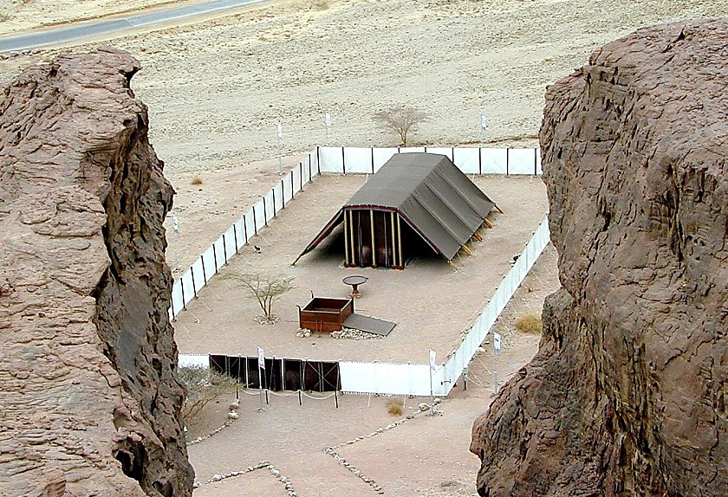
“MOSA GEINU DIETSEIDIEKHO-U”
I
II
III
IV
V
VI
VII
VIII
IX
X
TUOKEPRA KHUSO 20:
THEZHO KER KO
“M”
“The Diekhakeshii Kerko”
Dietsidiekhobou, Mizhii mu Mepfinuobuo
The First Table –
Duties to God (Verses 1-12)
Special Ordinances
Siiu la chiiketuoko
Mese pie kechii Riisuo bau mu Ki-u
The Second Table –
Duties to Men (verses 13-17)
A System of Worship
Puo Zievo-u
Zievo-u chii kemesa ketuo
“T”
Guidelines for Living
CHAPTER 21-24:
THE SOCIAL ORDINANCES
Riisuobau gei la mharethenguko mu keriisuomiako
Mhakechiimiako mu Keriileizha...
“M”
KHUSO 25-31:
RIISUOKIU NU LA THEZHOKO
MEDZI MOROKESUO ZHO
08
11
Notes:
And the FINAL “C” of M-C-C...this one representing the CEREMONIAL part of the Law.
//// Chapters 25-31: called the Tabernacle Ordinances…that ancient worship center shown here in a modern model out in today’s Israeli desert…built according to the Old Testament directions. And again we must remember that these new regulations were being provided for a people just coming out of four centuries of debilitating slavery and a culturally stunted growth.
//// These SPECIAL ORDINANCES were given to turn the people directly to the worship of their God while providing them
//// with A SYSTEM OF WORSHIP in the new Tabernacle, along with the new
//// GUIDELINES FOR LIVING among themselves, alone, and in the conditions of the desert wilderness.
//// Which included…the Tabernacle’s Ark, Table and Candlestick
//// Directions for its General Construction,
//// The Bronze Altar and the Court,
//// Its Priesthood for its ritual services,
//// Consecration of the Priesthood,
//// The Altar of Incense and the Worshippers, and
//// The Workmen in relation to the Sabbath.

Slide 10
I
II
III
IV
V
VI
VII
VIII
IX
X
“MOSA GEINU DIETSEIDIEKHO-U”
RHEPIE MEHO LA KESHII:
“K”
KHUSO 20:
THEZHO KER KO
“T”
KHUSO 21-24:
THEMIA KRO-U LA THEZHO KHAKESHII
“M”
KHUSO 25-31:
RIISUOKIU NU LA THEZHOKO
09
3
Notes:
So...the Mosaic Covenant, summed up…in its three distinct parts…
//// THE DECALOGUE…M…the MORAL PART…
//// THE SOCIAL ORDINANCES…C…the CIVIL PART…and
//// THE TABERNACLE ORDINANCES…another C…the CEREMONIAL PART…all given to Moses by the Lord…and then to the people...in all of their complexities and far-reaching implications -- even into our own day.

Slide 11
Mosa ze dietseidiekho kechiiu nunu ngukelie
1. Doyopuo la mhachii keshii.
2. Thepha sa di kepfhekho keshii.
3. Jisu Khrista mhathoko geinu thela nu mhaca hako chiitseiphrelie. Sii nunu puo thela chii lie.
4. Kemesa ruopfii rupie kijii nu khawakeshii sie,
4. Kemesa ruopfii rupie kijii nu khawakeshii sie, Thezho-u kelhou zho puo chiita mu siiu kepelemia ko miapuo puo kecii melou nu tuota !
9.65.05B.
4
©2006 TBBMI
10
Notes:
So…what were some of those implications of the Mosaic Covenant?
At least…these four…
//// the Mosaic Covenant was a TEMPORARY arrangement. It had a beginning and it had an end.
//// It was a CONDITIONAL agreement. You do THIS, God will do THAT. And then…some 1500 years later…in Jerusalem…on Calvary…
//// ….it had served its purpose at the conclusion of Jesus Christ’s ministry. It ended there. Finally…
//// After the Holy Spirit was introduced into the earth – following the Lord’s Ascension -- the Mosaic Law became an internalized part of the life and heart of each believer. Jeremiah had foretold that enormous change in man’s heart when He announced the New Covenant.
Jesus himself attested to his place in the history of the Law…

Slide 12
MATHI 5:17
Jisu pukecii:
“Nieko a ii Mosa zho-u siedzekesiko dieko bie pejiiwatuoii vorkechii medo hiecie; a siiko bie pejiiwatuoii di monyii chii tseishiituoii di kevor zo.”
a siiko bie pejiiwatuoii di monyii chii tseishiituoii di kevor zo.”
11
1
Notes:
In Matthew 5:17, he said..."Do not think that I have some to abolish the Law or the Prophets.
//// I HAVE NOT COME TO ABOLISH THEM BUT TO FULFILL THEM." Remember in the JESUS FILE, where we mentioned the implications of the Cross? This statement is at the core of that enormous event…a profound shift in man’s relationship to his Creator through the new Gospel ministry of the Messiah.

Slide 13

ABRAHAM
GEINU
DIETSEIDIEKHO-U
Abraham Kekie Kerie 12:1-3
Dietseidiekho-u Kerie 15:9-18
Dietseidiekho ko do nunu huo vacha kemeyie keshii
KEPHRII KHRUOHI #14
Ketholeshii Nu Pesikeshii “Mviidzeu”
12
©2006 TBBMI
9.65.05B.
Notes:
Now…using Study Help #14…let's return to dig a little deeper into that backbone of Biblical revelation…THE ABRAHAMIC COVENANT. We’ll develop the so-called amplified sub-covenants of God’s UNCONDITIONAL COVENANTAL PROGRAM with man …

Slide 14
Abraham Kekie Kerie 12:1-3
ABRAHAM
GEINU
DIETSEIDIEKHO-U
Dietseidiekho-u Kerie 15:9-18
KECHACHIE
PUOCAII
THEPHA KEJII
Kerie 13:15
Kerie 13:14-16
Kerie 15:9-18
KIJII
PUOSI
THEJA
Kerie 12:1
Kerie 12:2
Kerie 12:3
Ketholeshii Nu Pesikeshii “Mviidzeu”
13
©2006 TBBMI
9.65.05B.
Notes:
…the LAND, SEED AND BLESSING aspects of the Abrahamic arrangements….and their qualities as:
//// ETERNAL, LITERAL, and UNCONDITIONAL.

Slide 15
KIJII
DIETSEIDIEKHO-U
Abraham Kekie Kerie 12:1-3
ABRAHAM GEINU DIETSIDEIKHO-U
Dietseidiekho-u Kerie 15:9-18
KECHACHIE
PUOCAII
THEPHA KEJII
Kerie 13:15
Kerie 13:14-16
Kerie 15:9-18
KIJII
PUOSI
THEJA
Kerie 12:1
Kerie 12:2
Kerie 12:3
Dietseidiekho ko do nunu huo vacha pezha mu kemeyie keshii
Kijii
Pula 30:1-10
Ketholeshii Nu Pesikeshii “Mviidzeu”
14
©2006 TBBMI
9.65.05B.
Notes:
Beginning with the Land Covenant...sometimes called by its earlier name, the Palestinian...
//// This is the first amplification of the Abrahamic Covenant…the land portion.

Slide 16
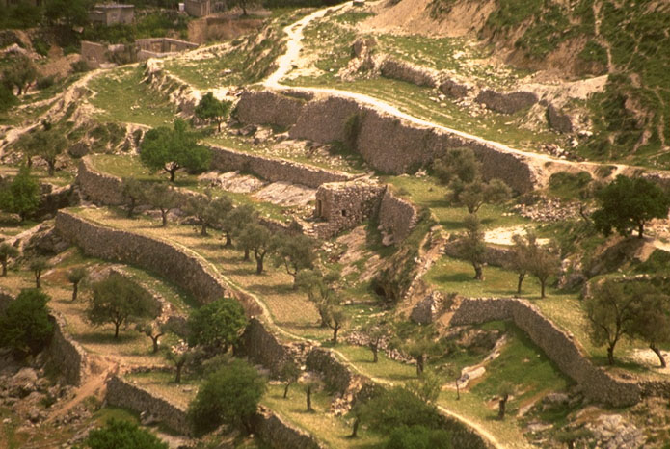
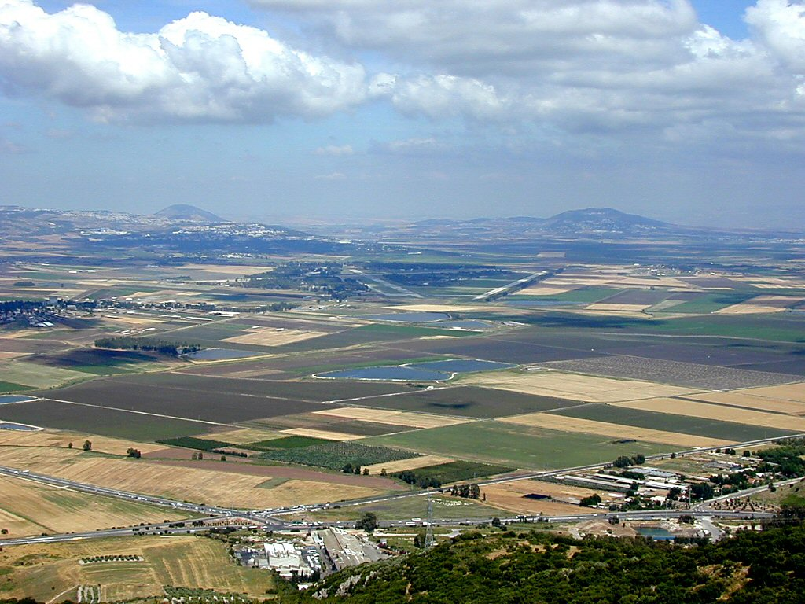
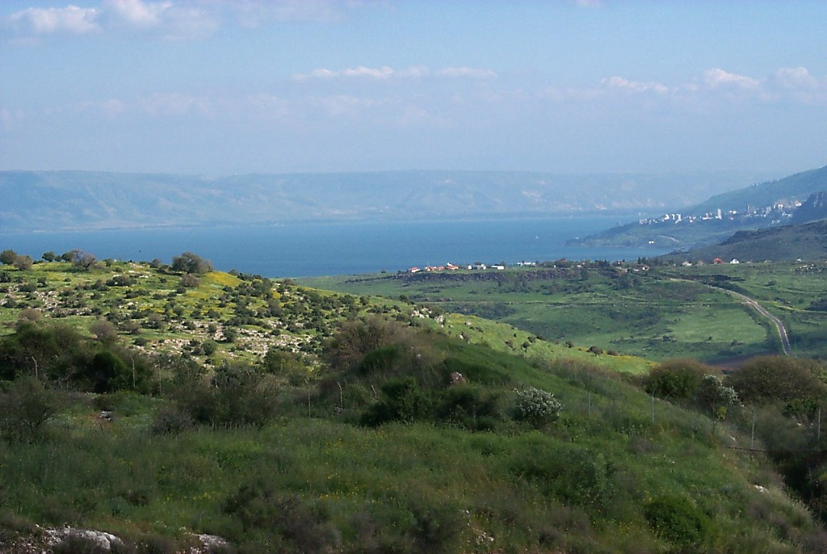
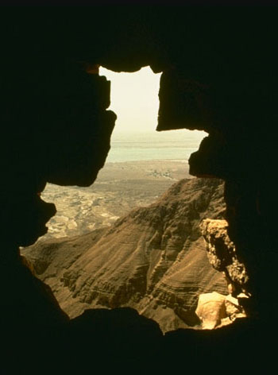
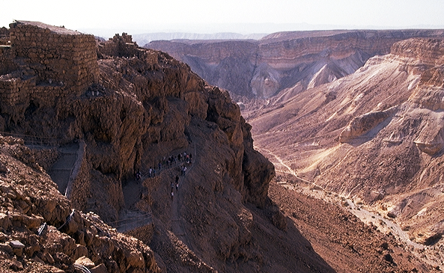
Abraham kayie kijii ko
15
Notes:
First…take a look at the Land of Abraham’s inheritance…remember that this was…and is…real acreage…real land…real lakes…farm fields…orchards…deserts and canyons. A place of great beauty and enormous wealth potential…

Slide 17
PULAKESHIIZHO 30
KIJII KHASHIITUOII DI PHRAKESHII DIE
⁵ Mu Jihova n Kepenuopfii n puonuoko peviekechii kijiiu nu n ze vorshiituo, mu noa siiu pevielietuo . Mu puoa n chii pevishiituo, sidi n chii pekruopie n puonuoko ki krashiituo.
⁶ Mu Jihova n Kepenuopfii nie bu nie melou pete se mu nie kerheiro pete se Jihova nie Kepenuopfii khrielie di rheilieketuo la nie melou mu nie nuosenuoyie melou zhiirewatuo.
16
2
Notes:
THE LAND PROMISE is recounted by Moses in Scripture at Deuteronomy 30, verses 1-10. In the heart of those ten verses lie these two:
//// ⁵ He will bring you to the land that belonged to your fathers, and you will take possession of it. He will make you more prosperous and numerous than your fathers.
//// ⁶ The Lord your God will circumcise your hearts and the hearts of your descendants so that you may love him with all your heart and with all your soul, and live.

Slide 18
KIJII KEZIEVI MU SIINU KINYI KEBA
17
Notes:
The words of that promise, made here to Moses, reflect God's earlier promises to Abraham, stating clearly that, in some distant day, both Israel AND Judah will return to their land to live in peace with their neighbors…a land of enormous beauty and material prosperity.

Slide 19
DAVID GEINU
DIETSEIDIEKHO-U
Abraham Kekie Kerie 12:1-3
Dietseidiekho-u Kerie 15:9-18
ABRAHAM GEINU DIETSIDIEKHO-U
KECHACHIE
PUOCAII
THEPHA KEJII
Kerie 13:15
Kerie 13:14-16
Kerie 15:9-18
KIJII
PUOSI
THEJA
Kerie 12:1
Kerie 12:2
Kerie 12:3
Dietseidiekho ko do nunu huo vacha pezha mu kemeyie keshii
Kijii
David
Pula 30:1-10
2 Sam 7:4-16
Ketholeshii Nu Pesikeshii “Mviidzeu”
18
©2006 TBBMI
9.65.05B.
Notes:
Now...the Davidic Covenant...
//// ….an amplification of the SEED portion of the Abrahamic...
2 Samuel 7, verses 4-16.

Slide 20

DAVID GEINU DIETSEIDIEKHO-U
MHACA SE CHIITOU KETUO PUKESHII
2 Samuel 7
¹⁶ Tsiu n kiu siro n kedi kechachie n mhodzii balietuo; n kedibau kechachie balietuo.
kechachie
kechachie
19
6
©2006 TBBMI
9.65.05B.
Notes:
Again...at the heart of that scripture…
//// is the great Davidic Covenant and its three guarantees…
/// It has this statement: 2 Samuel 7:16…to David through his household prophet Nathan…God says, “Your house and your kingdom will endure forever before me; your throne will be established forever.”.
To clarify:...
//// Your HOUSE.. or your lineage or family line...and your
//// KINGDOM...meaning actual real estate over which to govern...
//// and your THRONE...meaning a governmental administration...will be established…
//// …forever. Not just until the end of modern history, but forever...into eternity. So this verse then becomes a key idea in understanding Biblical eschatology or a study of The End Times.

Slide 21
Siila hau ntho nketso shiicie: Supuo-e David Kediba gei balie sii tuo ga?
Siila hau ntho nketso shiicie: Supuo-e David Kediba gei balie sii tuo ga?
20
©2006 TBBMI
9.65.05B.
Notes:
So, then, the question must be asked…AFTER King David’s day…1000 B.C….who is qualified to sit on that Davidic throne?

Slide 22
DAVID GEINU KEVOR KEDI YIE
Jisu Khrista kedi yie miako
KEPHRII KHRUOHI #16
21
1
©2006 TBBMI
9.65.05B.
Notes:
Which…then… leads directly to the question of the DAVIDIC DYNASTY. With Study Help #16 we’ll find some answers. Because throughout the New Testament, we find…over and over again…
//// references to Jesus as the Son of David…a bloodline product of the Davidic dynasty…or THE ROYAL GENEALOGY OF JESUS CHRIST!

Slide 23
DAVID YIE-U: Jisu Khrista kedi yie miako*
*KEKRA KEBA NUNU CHII PEDZII KESHII
22
1
Notes:
What about the genealogy of the Lord Jesus Christ, out of that line of David, according to Scripture? What do the scriptures have to say about all that? We are given a long and complex genealogy...
/// so this one will be vastly abbreviated.

Slide 24
DAVID YIE-U: Jisu Khrista kedi yie miako*
ADAM EVE
Ketholeshii nu ngukelie:
Keriekitho 3:20
*KEKRA KEBA NUNU CHII PEDZII KESHII
23
Notes:
We begin with Adam and Eve, first recounted in Genesis 3:20...

Slide 25
DAVID YIE-U: Jisu Khrista kedi yie miako *
ADAM EVE
Ketholeshii nu ngukelie:
Keriekitho 4:1-2; 4:8
KAIN ABEL
*KEKRA KEBA NUNU CHII PEDZII KESHII
24
1
Notes:
From their union came the brothers Cain and Abel.
//// And we know that Cain slew Abel because of Cain's jealousy of the gifts Abel made in sacrifice to the Lord. As a replacement for that murdered brother who was more favored by God, another son was born to Adam and Eve...

Slide 26
DAVID YIE-U: Jisu Khrista kedi yie miako *
ADAM EVE
Ketholeshii nu ngukelie:
Keriekitho 4:25
KAIN ABEL SETH
*KEKRA KEBA NUNU CHII PEDZIIKESHII
25
Notes:
He was Seth, the beginning of a godly line of men. AND RIGHT HERE is where the royal genealogy of Jesus Christ gets underway.

Slide 27
DAVID YIE-U: Jisu Khrista kedi yie miako *
ADAM EVE
Ketholeshii nu ngukelie:
Keriekitho 5:29
KAIN ABEL SETH
NOAH
*KEKRA KEBA NUNU CHII PEDZIIKESHII
26
Notes:
From Seth...followed Noah. By the way...dotted lines represent an abbreviation of all the Biblical names that actually occur during the long lines of descent. Scripture tells us the names of each one.

Slide 28
DAVID YIE-U: Jisu Khrista kedi yie miako *
ADAM EVE
Ketholeshii nu ngukeliei:
Keriekitho 11:26
KAIN ABEL SETH
NOAH
ABRAHAM
*KEKRA KEBA NUNU CHII PEDZIIKESHII
27
Notes:
Eventually through this line...we arrive at Abraham.

Slide 29
DAVID YIE-U: Jisu Khrista kedi yie miako *
ADAM EVE
Ketholeshii nu ngukelie:
Mathi 1:2-6
KAIN ABEL SETH
NOAH
ABRAHAM (Sarah)
*KEKRA KEBA NUNU CHII PEDZIIKESHII
DAVID
28
Notes:
And from Abraham, a thousand years later, appears David..

Slide 30
DAVID YIE-U: Jisu Khrista kedi yie miako *
ADAM EVE
Ketholeshii nu ngukelie:
2 Samuel 12:24
KAIN ABEL SETH
NOAH
ABRAHAM
*KEKRA KEBA NUNU CHII PEDZIIKESHII
DAVID BATHSHEBA
29
Notes:
And...among other of David's several wives...appears Bathsheba.

Slide 31
DAVID YIE-U: Jisu Khrista kedi yie miako *
ADAM EVE
Ketholeshii nu ngukelie:
2 Samuel 5:14
KAIN ABEL SETH
NOAH
ABRAHAM
*KEKRA KEBA NUNU CHII PEDZIIKESHII
DAVID BATHSHEBA
NATHAN SOLOMON
30
Notes:
Among the children of David and Bathsheba are these two sons: Nathan and Solomon. And here the line splits. Note that. It's a crucial place.

Slide 32
DAVID YIE-U: Jisu Khrista kedi yie miako *
ADAM EVE
Ketholeshii nu ngukelie:
Luk 3:23 Mu Kekrei rei sa
KAIN ABEL SETH
NOAH
ABRAHAM
*KEKRA KEBA NUNU CHII PEDZIIKESHII
DAVID BATHSHEBA
NATHAN SOLOMON
LUK 3:23 (kekreiko rei mehoshi)
MARIA
31
Notes:
From the line of son Nathan, eventually appears Mary, the mother of Jesus.

Slide 33
DAVID YIE-U: Jisu Khrista kedi yie miako *
LUK 3:23 (kekreiko rei mehoshi)
Luk 3:23: “Siisie Jisu mia petha chie sietuoiikezhii ki puo penuokelie chie ser meseta; mu themia noule mhie ro puo Josef nuo.”
“Luke-e Maria yie miako pfiivor. Thedze vacha ya kezhamia kekra rei [puorhei kekrei krei kecii nunu…] Luke ha iise Maria yie miako pfii separ di puo rei iise David geinu kepar yiemia zo, siila, Joseph geinu zo modi Maria geinu rei sadi Jisu ha Kenhekelie-u chii sii zo, isi (Josef-e David geinu kevor yie miako donu phichii tho-u ciila).”
Louis Barbieri, The Bible Knowledge Commentary, eds. John Walvoord & Roy Zuck (Victor Books, 1983), 212.
32
1
Notes:
Luke wrote about this in his Gospel. In his third chapter, verse 23: “Now Jesus himself was about 30 years old when He began His ministry. He was the son, SO IT WAS THOUGHT, of Joseph.”
//// This further explanation from two eminent Bible scholars: “Luke was tracing the line of Mary. Many interpreters [among varied other positions…] argue that Luke was giving the genealogy of Mary, showing that she also was in the line of David and that therefore Jesus was qualified as the Messiah, not only through Joseph (since he was the oldest legal heir) but also through Mary.”

Slide 34
DAVID YIE-U: Jisu Khrista kedi yie miako *
ADAM EVE
Ketholeshii nu ngukelie:
Mathi 1:16
KAIN ABEL SETH
NOAH
ABRAHAM
*KEKRA KEBA NUNU CHII PEDZIIKESHII
DAVID BATHSHEBA
NATHAN SOLOMON
MARIA JOSEF
33
Notes:
And from Solomon’s side...the line of descent leads directly to Joseph, Jesus' FOSTER-father. And then the climactic event of the ages...from Joseph and Mary, through the intervention of the Holy Spirit in Mary’s womb…

Slide 35
DAVID YIE-U: Jisu Khrista kedi yie miako *
ADAM EVE
Ketholeshii nu ngukelie:
Mathi 1:16
KAIN ABEL SETH
NOAH
ABRAHAM
*KEKRA KEBA NUNU CHII PEDZIIKESHII
DAVID BATHSHEBA
NATHAN SOLOMON
MARIA JOSEF
JISU KHRISTA
34
Notes:
…the Lord Jesus Christ enters the earth. And, you might say, “well…we all know that. What is the importance of such an emphasis on it?” Answer: earthly kingship presents two requirements...

Slide 36
DAVID YIE-U: Jisu Khrista kedi yie miako *
ADAM EVE
KAIN ABEL SETH
NOAH
ABRAHAM
DAVID BATHSHEBA
NATHAN SOLOMON
CHII-ZIE GEINU KEKAYIE
THEZHO-U NUNU KEKAYIE
KIKRU puo puo mezhii
Luk 3:23-38
THEZHO-U nunu puo mezhii
Mathi 1:1-17
MARIA JOSEF
JISU KHRISTA
35
3
Notes:
FIRST…a family qualification by right of a bloodline succession.
//// SECOND…there must also be a legal qualification by right of traditional succession.
//// The family right and blood line through Mary – the mother of Jesus – as it is laid out in Luke's gospel, third chapter, verses 23-38,
//// While the legal line of Jesus’ father – Joseph -- appears in detail in Matthew’s Gospel, chapter 1, verses 1-17.
Much has been written all about this...far more than can be described here. So you are encouraged to dig into these ideas. They are rich with meaning, significance and credibility toward establishing the Lord’s place in the great Plan of the Ages.

Slide 37
DAVID YIE-U: Jisu Khrista kedi yie miako *
ADAM EVE
KAIN ABEL SETH
NOAH
ABRAHAM
DAVID BATHSHEBA
NATHAN SOLOMON
KIKRU puo puo mezhii
Luk 3:23-38
THEZHO-U nunu puo mezhii
Mathi 1:1-17
CHII-ZIE
GEINU
KEKAYIE
MARIA JOSEF
JISU KHRISTA
36
Notes:
So...to sum up...
Mary, Jesus’ birth mother, supplies his bloodline directly back to the throne of David...and beyond.

Slide 38
DAVID YIE-U: Jisu Khrista kedi yie miako *
ADAM EVE
KAIN ABEL SETH
NOAH
ABRAHAM
DAVID BATHSHEBA
NATHAN SOLOMON
KIKRU puo puo mezhii
Luk 3:23-38
THEZHO-U nunu puo mezhii
Mathi 1:1-17
CHII-ZIE
GEINU
KEKAYIE
THEZHO-U
NUNU
KEKAYIE
MARIA JOSEF
JISU KHRISTA
37
Notes:
...and Joseph…as the foster-father and a descendant of King Solomon… has the right of legal succession to bestow upon his foster son, Jesus. A remarkable evidence of the credibility and reliability of the Scriptural record.

Slide 39
Criswell, W. A.
Danker, Frederick
Ellis, E. Earle
Fitzmeyer, Joseph
Godet, F. A.
Hendricksen, William
Hoehner, Harold
Ironside, F. A.
Marshall, I. Howard
McGee, J. Vernon
Morgan, G. Campbell
MacArthur, John
Scofield, C. I.
Swindoll, Charles
Unger, Merrill
Walvoord, John
Zuck, Roy
Jisu kelhou yiemia dze thuya kezha kekra keba nu mia huomia ko:
38
©2006 TBBMI
9.65.05B.
Notes:
Here is a list of only a few of the dozens of authors who have written extensively on the genealogy of Jesus Christ as it is presented in the Gospels of Matthew and Luke. There are many, many more than these!

Slide 40

PUORHEI RIIKRII ZO KECII NUNU KIKEMHIE DI JISU KHRISTA PENUO MU LHOU VOR SHI, NO LESHII YAMO?
KERKRII KELIE PUO NUNU PENUOLIE MA?
KEPHRII KHRUOHI #17
39
2
©2006 TBBMI
9.65.05B.
Notes:
With Study Help #17 in hand…place yourself here in a rocky field outside Bethlehem where a shepherd tends his flock –– as it has been for thousands of years on this same land…just outside that ancient little town where Jesus was born. From here you could have seen and heard the angelic announcement of his miraculous birth! Which leads to another another question…
//// Have you ever considered the astonishing statistical probabilities of the birth and life of Jesus Christ?
//// Was it just an accident of birth?

Slide 41
PUORHEI RIIKRII ZO KECII NUNU KIKEMHIE DI JISU KHRISTA PENUO MU LHOU VOR SHI, NO LESHII YAMO?
*
KERKRII KELIE PUO NUNU PENUOLIE MA?
KETHOLESHII KEWEU NU:JISU KHRISTA KEPENUO,PUO LHOUKEVOR MU PUO GOU KEWA GEINU KETHOLESHII KEWEU NU VA 300 KEZIE KENHEKELIEU VOR KETUO DZE PUPIE KETUOKO CHII TSEIWATE. SIZOII REI…
KEPHRII KHRUOHI #17
*Source: Josh MacDowell, Evidence That Demands A Verdict, 1972, page 175; Peter Stoner, Science Speaks, Moody Press, 1963.
40
Notes:
In the Old Testament…more than 300 references to a coming Messiah were fulfilled upon the birth, life and crucifixion of Jesus Christ. So then, with that said, according to established scientific techniques of probability and statistics.

Slide 42
SIZOII REI…
SIITEIU NUNU VOR TSIE KETSO MIAPUO KELHOU NU MHACA 8 RIIBEI ZOREI CHIITUOII DI PUPIE KEZHII CHIITSEI LIE KETUO KEMERII KIDE BAGA?
_{KELAKESHII:SOIINYIE NYIE ZA}
_{KRIEPUO DONU ZA PUO (10} ¹⁷₎
_{1:100,000,000,000,000,000}
*Source: Josh MacDowell, Evidence That Demands A Verdict, 1972, page 175; Peter Stoner, Science Speaks, Moody Press, 1963.
41
2
Notes:
What, then, are the chances of only EIGHT predictions being fulfilled in the life of any one individual between then and now?
//// The answer: one chance in 100 quadrillion…or…10 to the 17th!
//// and here is what that number looks like typed out!
If you think that is incredible…here comes another one.

Slide 43
DOUPUO LE KEHIE SASHII KHE…
SIITEIU NUNU VOR TSIE KETSO MIAPUO KELHOU NU(300 DONU)MHA 40 ZOREI CHIITUOII DI PUPIE KETUO CHIITSEI KELIE:
KELAKESHII: Soiinyie nyie donu za puo 10¹⁵⁷
1:10,000,000,000,000,000,000,000,000,000,000,000,000,000, 000,000,000,000,000,000,000,000,000,000,000,000,000,000, 000,000,000,000,000,000,000,000,000,000,000,000,000,000, 000,000,000,000,000,000,000,000,000,000,000,000
*Source: Josh MacDowell, Evidence That Demands A Verdict, 1972, page 175; Peter Stoner, Science Speaks, Moody Press, 1963.
42
3
Notes:
Another measure of scientific probability…
//// Then…with just 48 of the 300 predictions being fulfilled in the life of any one individual between then and now:
//// The answer: one chance in 10 to the 157th!
//// Typed out…here you are!
Before your very eyes…statistical probabilities produced by a world-renowned scientist…according to established scientific procedures of statistics and probability.

Slide 44
David geinu kevor kedi yie*
KEPHRII KHRUOHI #16
MARIA
JOSEF
Luk 3:23-38
Mathi 1:1-17
• UCHII UZIE GEINU KEPAR
• Pesie se Adam gei la kevo
Maria geinu kevor,
puo nuose nuoyie
• Maria geinu kepar puo nuose
nuoyie
• David geinu kepar Tsie
(2 Sam 7:12, 13; Rom 1:3)
•KEDIYIE,THEZHO-U
NUNU KESEYIE KEVOR
• Abraham geinu pedzii meho
keshii
Josef geinu kepar, David
nuou
• Thezho-u geinu keseyie
• Judamiako ki pesipengukeshii
Jisu Khrista Kediu kepenuo
43
16
Notes:
Now…with all this said, let’s summarize the ROYAL GENEALOGY OF JESUS CHRIST…along with Study Help 16…
//// ….Mary…produced the bloodline for the Messiah.
//// ….This Lucan genealogy traces the Lord’s bloodline
backward to Adam.
//// ….through Mary.
//// ….it’s the lineal descent.
//// ….It’s a personal genealogy…
//// ….through Mary.
//// ….A seed of the House of David…
//// ….All of it recounted in 2 Samuel and Romans.
Meanwhile…from Joseph’s side…
//// ….This is the Royal
//// ….Legal line.
//// ….Moving forward from Abraham…
//// ….As a son of David…
//// ….through Joseph…
//// ….the Legal Line…
//// ….As a revelation to the Jew…
//// ….both lines of descent then producing….THE ROYAL BIRTH …INTO THE EARTH…OF THE LORD JESUS CHRIST.

Slide 45


JISU TEIKI THIEDZII JERUSALEM RHI-U
JISU TEIKI NIATHU TSATIE NU HERODIA RIISUOKI NU KELE KECIEU
44
Notes:
Taken together, we can see that when Jesus entered
the City of Jerusalem on Palm Sunday he was approaching…the eastern entrance to the great Herodian Temple with the apparent purpose –– so the people thought –– of actually claiming the Throne of David as his own.

Slide 46

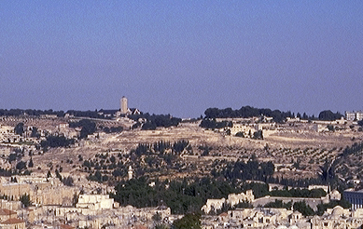
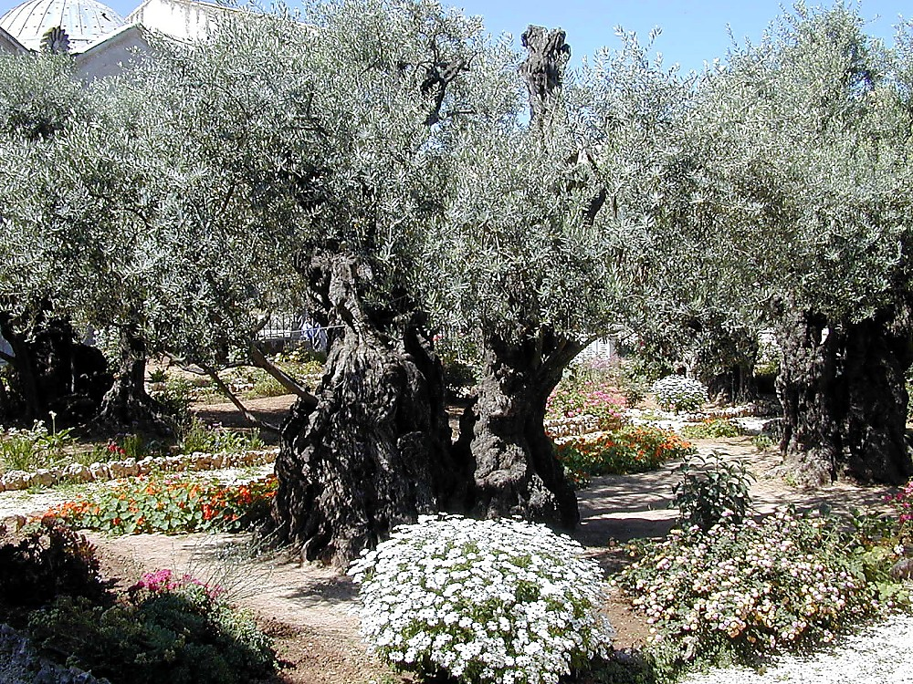
Herod Kekuo Kezhau chiikeshii “Riisuoki Kenieu”
OLIV KIJIITHOU
Thiedzii Oliv nhau Gethsemane zieu nu
45
2
Notes:
It all happened here… in the massive armed precincts of Herod’s great Temple on the same site as Solomon’s earlier Temple and before that, the mountaintop where Abraham was instructed to sacrifice Isaac 2000 years earlier…
….and on the Mount of Olives…in the outskirts of the ancient city of Jerusalem…
…and the Lord’s agony in the Gethsemane garden.

Slide 47
Abraham Kekie Kerie 12:1-3
DietsEidiekho-u Kerie 15:9-18
DIETSEIDIEKHO
KESAU
ABRAHAM
GEINU DIETSIDIEKHO-U
KECHACHIE
PUOCAII
THEPHA KEJII
Kerie 13:15
Kerie 13:14-16
Kerie 15:9-18
KIJII
PUOSI
THEJA
Kerie 12:1
Kerie 12:2
Kerie 12:3
Dietsidiekho ko do nunu huo vacha pezha mu kemeyie keshii
Kijii
David
Kesa
Pula 30:1-10
2 Sam 7:4-16
Jer 31:31-34
Ketholeshii Nu Pesikeshii “Mviidzeu”
46
1
©2006 TBBMI
9.65.05B.
Notes:
The appearance of the Lord in Israel 2000 years ago leads directly to the last of the amplified subcontracts of the Abrahamic Covenant. This last one is...the NEW COVENANT...
//// ….a further expansion on the message and implications of that BLESSING part of the Abrahamic. We find it in Jeremiah 31:31-34.

Slide 48
Jeremiah 31
DIETSEIDIEKHO KESAU
KEDIMIAKO
(1000 B.C.)
Jeremiah-e mha kerese ze kese kecii puo nu tha…
S - D - S
••• KEZA •••
Peso Pekhro
Israel
Judah
10 2
SIEDZEKESIKO
19-J 20-R
200 350
“Judah puo tei kere puo nu ketha”
Assyria Babilon
47
2
Notes:
We’ll become more familiar with Jeremiah further on. But for now…Jeremiah is the Bible’s central figure in delivering the New Covenant announcement…a new arrangement just over the prophet’s historical horizon from his Old Testament time!
//// Think about the prophet’s severe circumstances at the time he was writing…They are right there in the ROYALTY FILE FOLDER. Jeremiah appeared in the time of THE PROPHETS.
The United Kingdom had split apart. Jerusalem was soon to be destroyed by the approaching Babylonians. In spite of those terrible times, Jeremiah pronounced a message of incomparable brilliance and optimism…a piece of “good news” that would echo through the coming centuries...awaiting only the appearance of Messiah to fulfill his vision.
//// …Yes…Jeremiah’s circumstances were severe…JUDAH WAS IN CRISIS!

Slide 49
Jeremiah 31
DIETSEIDIEKHO KESAU
³¹ “Harie teisozhako vorzhie,” Jihova sikechii puya, “Siikisii a-a Israel kinuko ze [Pesotsatie Kedibau] mu Judah kinuko ze [Pekhrotsatie Kedibau] dietseidiekho kesalietuo.
48
4
Notes:
Here are those amazing words from Jeremiah 31... This is THE NEW COVENANT announcement! Pay close attention to every word!
//// Calling out verse 31 specifically..."The time is coming," declares the Lord, "when I will make a NEW COVENANT with the house of Israel”…the Northern Kingdom… “and with the house of Judah”…the Southern Kingdom.
//// A new covenant…
//// with Israel…the Northern Kingdom, now dispersed…
//// and with Judah…the Southern Kingdom…a nation to go into captivity but with a promised return to the Land of Abraham’s inheritance.

Slide 50
Jeremiah 31
DIETSEIDIEKHO KESAU
³²A-a Ijipt kijii nunu uko dzie teshii kepar teiso-u nhie uko puonuoko ze dietseidiekho kechiiu kemhie lielho; a-a uko nupfu kemhiei zoshierei, a ze dietseidiekho kelie siiu uko-a varhuowa,” Jihova sikechii puya.
49
Notes:
"It will not be like the covenant I made with their forefathers when I took them by the hand to lead them out of Egypt, because they broke my covenant though I was a husband to them, " declares the Lord.”

Slide 51
Jeremiah 31
DIETSEIDIEKHO KESAU
³³ “Derei a-a Israel kinuko ze dietseidiekho kelieu haituo; teisozha siikosii sie,” Jihova sikechii puya.
“A-a a zho-u pie uko nou tsatie shiishiituo, tsiu siiko pie uko melou gei thushiituo; sidi uko Kepenuopfii chiituo, mu uko-a a themia chiituo.”
50
1
Notes:
This is the covenant I will make with the house of Israel after that time, declares the Lord.
//// [THIS PHRASE IS TYPED OUT ON SCREEN FOR EMPHASIS.] "I will put my law in their minds and write it on their hearts. I will be their God and they will be my people." Notice that this newly announced Covenant will be with BOTH HOUSES OF THE DIVIDED KINGDOM...BOTH JUDAH AND ISRAEL.
[John Walvoord, Roy Zuck; The Bible Knowledge Commentary – Old Testament Edition; Victor Books, 1985; page 1171

Slide 52
Ketholeshii Kesau nu pesikecii
Luk 22:19-20
¹⁹ Siisie puo niekhriida chii selie di, Ukepenuopfii tsheshii di bietsiepie uko tsiishii di sie, “Hauha nieko lanu khakeshii a mo zo: nieko a riikra tuolieketuo la hauha chiicie”, sishii.
²⁰Siro mha chiikelie sie puo siisii tuoi tehieu rei chiipielie di sie, “Tehie hauha nieko lanu kru kepar a zieu la dietseidiekhokelie thezho kesau zowe.
51
4
Notes:
Now move over to the New Testament...for the announcement at that time…
//// …The 22nd chapter of Luke...verses 19-20. At that final supper with his friends…Jesus
//// ..."took bread, gave thanks and broke it, and gave it to them, saying, “This is my body given for you; do this in remembrance of me.”
//// ²⁰In the same way, after the supper he took the cup, saying, “This is the …
//// …new covenant in my blood, which is poured out for you.”

Slide 53
Ketholeshii Kesau nu pesikecii
Mathi 26:26-28
²⁶ Siro uko mhachii keba nu Jisu niekhriida chii pielie di jashii di bietsielie; sidi puoa khapie pethakelieko tsiishii di sie, “Liepie chiiliecie; hauha a mo zo”, sishii.
²⁷Siisie puo tehieu rei pielie di jashii, di khapie uko tsii di sie, “Nieko hau krie phrechie.
²⁸Kekreilamonyii hauha themia kekra kephouma valieketuo la krukepar dietseidiekhokelie a zie zo kechii la.
52
4
Notes:
And then again...in the 26th chapter of Matthew...verses 26-28:
//// ²⁶While they were eating, Jesus took bread, gave thanks and broke it, and gave it to his disciples, saying, “Take and eat; this is my body.”
//// ²⁷Then he took the cup, gave thanks and offered it to them, saying, “Drink from it, all of you.
//// ²⁸This is my blood of the covenant, which is poured out for many for the forgiveness of sins.
//// Again…the Lord said clearly…MY BLOOD OF THE COVENANT!

Slide 54

Sunset from Kursi
HAKI MHA KEDIPUO CHII PAR TAZHII GA?
WHAT IS HAPPENING HERE?
KELAKESHII: U CHII KESHIIU MU PUO CHIIKESHII KO UNIE DONU KEPERO KECIIU THENOU KETHO SE DI RIIDI PAR!
53
1
©2006 TBBMI
9.65.05B.
Notes:
WHAT IS HAPPENING HERE? Jeremiah was announcing…and Jesus is establishing…
//// …the arrival of a profound change in the relationship between the Creator and His Created! Meaning…in a very practical sense.

Slide 55
Ketholesii Keweu teiki “SISHII MOROSUO” iketuo keleu riidi se……
54
©2006 TBBMI
9.65.05B.
Notes:
The ancient HAVE-TO mentality of the Old Testament and THE LAW had given way…

Slide 56
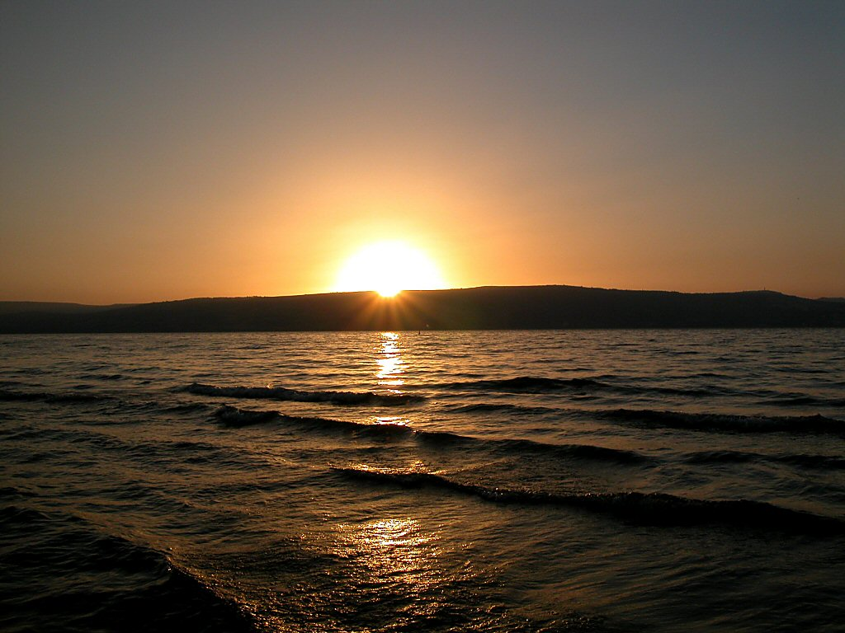
Sunset over Sea of Galilee
Ketholesii Keweu teiki “SISHII MOROSUO” iketuo keleu riidi se…..
…Ketholeshii Kesa teiu nu “SI NYII” ikeciiu nu par ta.
Kimhiedi ga? Kekreilamonyii kemesa ruopfii thenou hii keshii la – hau Kepenuopfii dieliekevi pele ya kezhamia ko pete geinu phrelie!
55
1
©2006 TBBMI
9.65.05B.
Notes:
The ancient HAVE-TO mentality of the Old Testament and THE LAW had given way. …to the WANT-TO mentality of the New Testament and the Gospel! A profound change, indeed. From the “HAVE-TO” OF LEGALISM – “Do this, do that” according to the strict Mosaic Regulations -- TO THE “WANT-TO” OF THE GENTLE INDWELLING HOLY SPIRIT!
//// How? Because of the internalized urgings of the Holy Spirit… ….to be available to every believer and living in every believer’s heart...to be available with the coming of the Messiah and His inauguration of the New Covenant. An approach to God no longer based on human performance on the outside…as in the time of The Law. But now…INSIDE THE HEART OF EVERY BELIEVER!…the time of THE NEW COVENANT!

Slide 57
Sunset over Sea of Galilee
THEZHO-UE
NGUKEMEZHIE
CHA-U PERIE SHII
56
©2006 TBBMI
9.65.05B.
Notes:
Summed up:
LAW HAD GIVEN WAY TO GRACE!
A time of enormous spiritual change had arrived. That change was destined to cause schism and friction – indeed, an explosion – in the Jewish community to which the Lord would be appearing…as the New Testament records tell us! It’s effect on world history would be profound!

Slide 58

SIILA UKO TSIE WE KETHOLESHII NU THUPIE KEZHII KO PUOCA KEMEYIE SILIE DI…
PELHOUKESHII
ABRAHAM
JOSEF
MOSA
JOSHUA
ULAKRIKO
KEDIMIAKO
ZAYIE CHII DI RHAKELIE!
MIADIA KECHII
ZIKETA
JISU
57
Notes:
Now we can understand the importance of the Biblical story line toward grasping THE GRAND PANORAMA OF REDEMPTION! Here also we can see in hindsight the foundation of the Church coming into view.

Slide 59
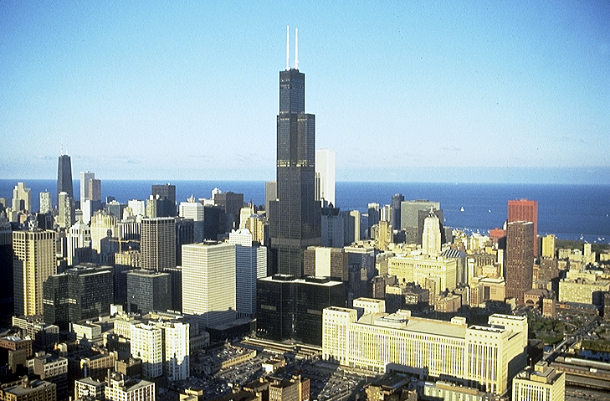


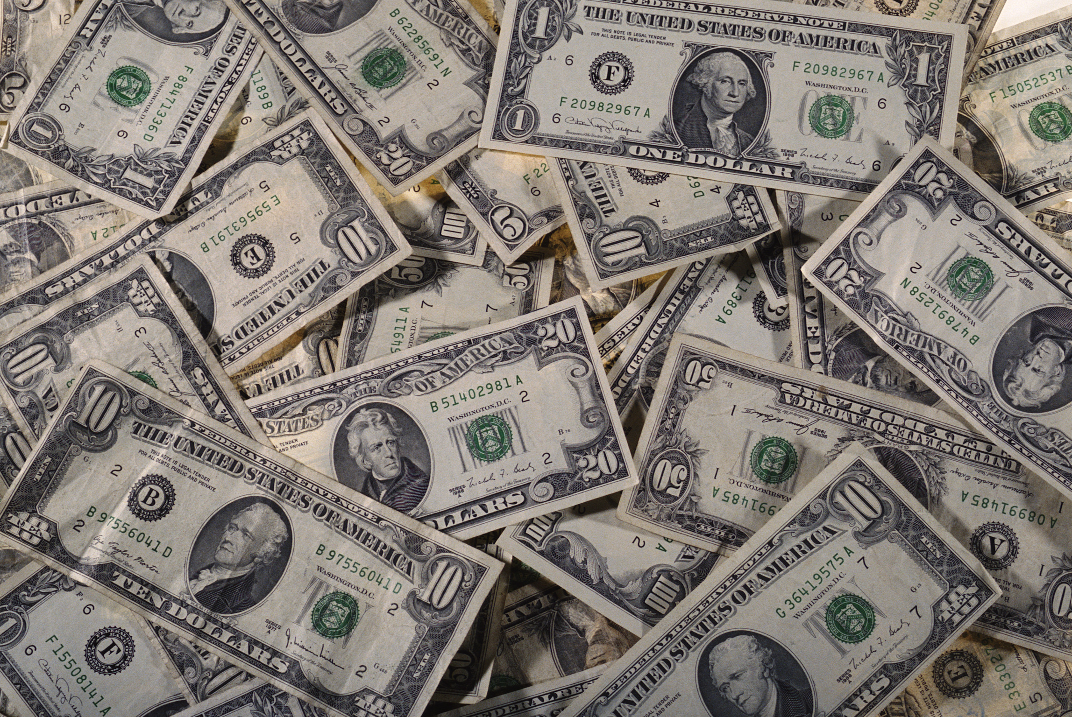

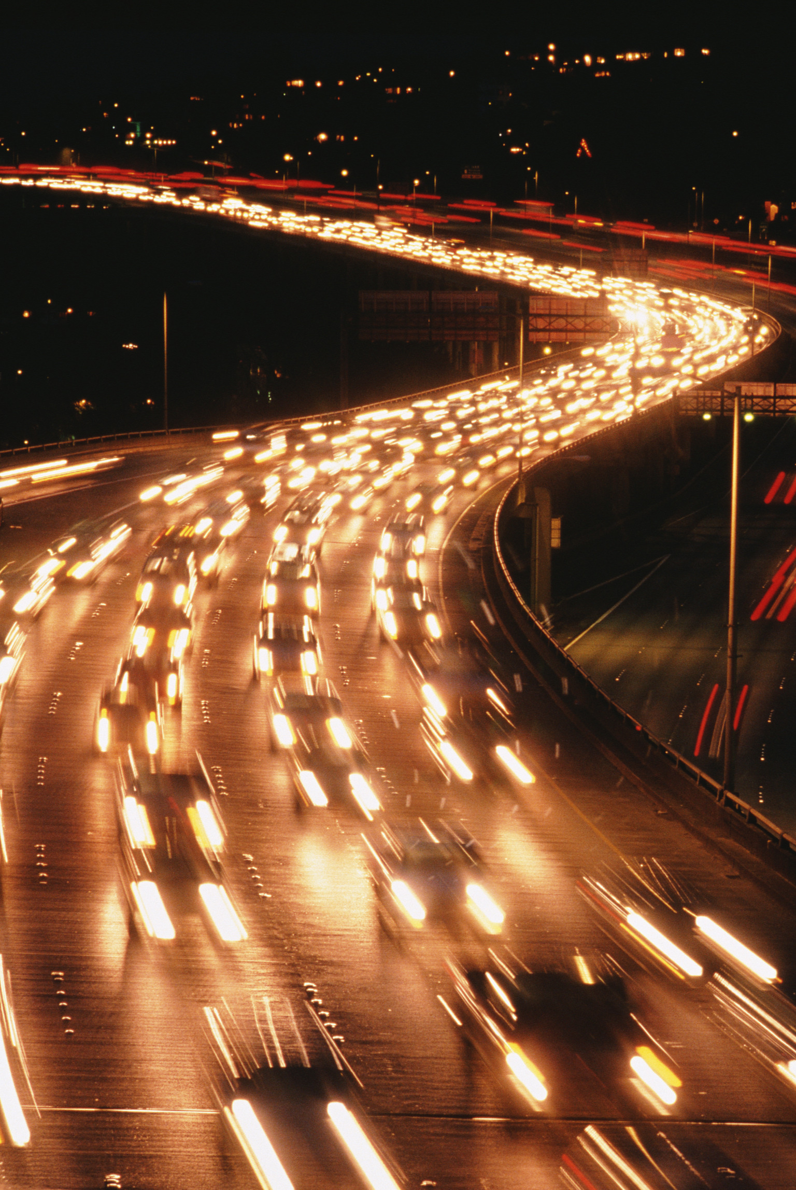
KETSOKESHII: TSIE KIJIIU NU MHANYAKO CHIIPEKHO MU CHII PEVI SE PIE KEBA TEI HAU NU, JISU PUO ZIE PEKRU PIE KEZHIIU HA MHA KEDIPUO II TUO GA?
58
Notes:
Now...one final question...in our world of high technology, satellites and computers, the Internet…for many the concept of a blood sacrifice or the meaning or necessity of Jesus’ blood sacrifice is downright disturbing. What about that? To clear up this issue…let’s turn again to God’s Word.

Slide 60
“THEZIE” ikecii cau nu...
Ibriko 9:15-22
¹⁵Sidi kielieketako bu
kechachie baketuo kau pupiekezhiiu ngulieketuo la dietseidiekho piekezhii kerieu khriikhronu thezho varhuoketuoko rhalieketuo la mia sou chii di siawa di dietseidiekho kesa lakechiiu nu puo thedonu kethau chiite.
59
2
Notes:
Hebrews 9 tells us...
¹⁵For this reason Christ is the mediator of
//// a new covenant, that those who are called may receive
//// the promised eternal inheritance — now that he has died as a ransom to set them free from the sins committed under the first covenant.

Slide 61
¹⁶Siro mha pupie mia tsiipiekezhii leshii zhii ro, mha pukeshiiu sia di ngulieya.
“THEZIE” ikecii cau nu...
Ibriko 9:15-22
¹⁷Kekreilamonyii siiu se sie mha pupiekezhii leshiiu puo kekuo nyitaya, derei mha pukeshiiu rheikeba chie we mhapuorei chiilie kenjiitakechii la.
60
1
Notes:
¹⁶In the case of a will, it is necessary to prove the death of the one who made it,
//// ¹⁷because a will is in force only when somebody has died; it never takes effect while the one who made it is living.

Slide 62
“THEZIE” ikecii cau nu...
Ibriko 9:15-22
¹⁸Siila dietseidiekho piekezhii kerieu rei thezie sa mo di pu pevilie suota zo.
61
Notes:
¹⁸This is why even the first covenant was not put into effect without blood.

Slide 63
¹⁹Sidi thiedzii Mosa bu thezho se di puo themia peteko ki die puo khakeshii metsei puo mithu nuonuo mu temvii zie pie dzii mu tekuo mie merie harakechii hisob nhapfii salie di kegepie leshiidau rei mu puo themia peteko rei va phreshii di sie
“THEZIE” ikecii cau nu...
Ibriko 9:15-22
62
Notes:
¹⁹When Moses had proclaimed every commandment of the law to all the people, he took the blood of calves, together with water, scarlet wool and branches of hyssop, and sprinkled the scroll and all the people.

Slide 64
“THEZIE” ikecii cau nu...
Ibriko 9:15-22
²⁰ “Hauha Ukepenuopfii nieko ki die khakeshii dietseidiekhokelie zieu zo we” isi siya.
²⁰ “Hauha Ukepenuopfii nieko ki die khakeshii dietseidiekhokelie zieu zo we” isi siya.
63
1
Notes:
²⁰ He said, “This is the blood of the covenant, which God has commanded you to keep.”

Slide 65
“THEZIE” ikecii cau nu...
Ibriko 9:15-22
²¹Mu siiu riibeizomonyii riisuo pfekiu mu siinu seyakezha mhabou pete gei rei siisii tuoi di puo thezieu kegepie va phrephreya.
64
Notes:
²¹In the same way, he sprinkled with the blood both the tabernacle and everything used in its ceremonies.

Slide 66
“THEZIE” ikecii cau nu...
Ibriko 9:15-22
²²Tsiu thezho siiu zo rei mha kekra tsa thezie se chii kemesalielie vor, mu thezie se mo di kejo vakelie jii zo.
65
Notes:
²²In fact, the law requires that nearly everything be cleansed with blood.

Slide 67
“THEZIE” ikecii cau nu...
Ibriko 9:15-22
²²Tsiu thezho siiu zo rei mha kekra tsa thezie se chii kemesalielie vor, mu thezie se mo di kejo vakelie jii zo.
thezie se mo di
66
1
Notes:
and without the shedding of blood there is no forgiveness.
So...finally...we come to understand that without
//// the shedding of blood...which represents the Creator's most precious gift to Man outside of His own son...the gift of life itself which resides in human blood.

Slide 68
“THEZIE” ikecii cau nu...
Ibriko 9:15-22
Sii-u samo di kejo vakelie bamo. U Niepuu Kalvari geinu kesia penyii wa mu hau geinu chii di morokesuo ko pete UKO SOU chiitsei shii te!
67
Notes:
Without that sacrifice there is no forgiveness. Our Lord provided that ultimate sacrifice when he went to Calvary and became victorious over death itself…IN OUR BEHALF!

Slide 69
KEPHRII KHRUOHI #14 & #32
Abraham Kekie Kerie 12:1-3
ABRAHAM
GEINU DIETSEIDIEKHO-U
Dietseidiekho-u Kerie: 15:9-18
KECHACHIE
PUOCAII
THEPHA KEJII
Kerie 13:15
Kerie 13:14-16
Kerie 15:9-18
KIJII
PUOSI
THEJA
Kerie 12:1
Kerie 12:2
Kerie 12:3
Dietseidiekho ko do nunu huo vacha pezha mu kemeyie keshii
Kijii
David
Kesau
Pula 30:1-10
2 Sam 7:4-16
Jer 31:31-34
Ketholeshii Nu Pesikeshii “Mviidzeu”
68
5
©2006 TBBMI
9.65.05B.
Notes:
So..with Study Helps 14 and 32 in hand…the Abrahamic Covenant can be seen now in its full grandeur...
//// …a Call to Abraham in Genesis 12…followed by…
//// …the making or “cutting” of the Covenant itself... in Genesis 15...
//// proclaiming its LAND, SEED AND BLESSING aspects....
//// …and seen to be ETERNAL IN ITS DURATION...LITERAL IN ITS MEANING...AND UNCONDITIONAL IN ITS APPLICATION...with each of the three parts amplified through later centuries
//// …in the form of the Land Covenant of Deuteronomy given through Moses...the Davidic Covenant of Second Samuel...and finalized in the New Covenant in the writings of Jeremiah.
//// THIS IS THE FULL IMPACT OF THE ABRAHAMIC COVENANT…THE VERY BACKBONE OF BIBLICAL REVELATION.

Slide 70



PFHE PUO DO KETUO LA KELO MEZO KEBAU LE LA SHII KHE!
TEICIE-U KESEDE DI KEBA HAU KETHODIE NU PFHEPHRIE PUO KEMHIE ZO
KEPHRII KHRUOHI #08
69
© 2006 TBBMI
9.65.05B.
Notes:
One final time let’s set up and thread that loom of Biblical chronology as shown in Study Help #8…

Slide 71
PFHE PUO DO KETUO LA KELO MEZO KEBAU LE LA SHII KHE!
TEICIE-U KESEDE DI KEBA HAU KETHODIE NU PFHEPHRIE PUO KEMHIE ZO
70
© 2006 TBBMI
9.65.05B.
Notes:
…15 threads on the loom... each vertical thread representing an event in the chronology and…

Slide 72
TEICIE-U KESEDE DI KEBA HAU KETHODIE NU PFHEPHRIE PUO KEMHIE ZO
7
JISU KIJII NU LA TSUR DI KECII
4T
3K
TEKUONUOP KIYAKECHII HE
TEI KESA, KIJII KESA
KEDIBA KEKRA KEZHAU
J
JISU LA KEVOR
P
A
J
M
J
K
K
K
Z
71
© 2006 TBBMI
9.65.05B.
Notes:
…according to many...the progressive events of earth’s history reach far out into the future until the end of time itself...

Slide 73
TEICIE-U KESEDE DI KEBA HAU KETHODIE NU PFHEPHRIE PUO KEMHIE ZO
7
KEHOU-U
JISU KIJII NU LA TSUR DI KECII
4T
3K
TEKUONUO KIYAKECHII HE
KEDIBA KEKRA KEZHAU
J
TEI KESA, KIJII KESA
JISU LA KEVOR
P
A
J
M
J
K
K
K
Z
ABRAHAM DIETSEIDIEKHO-U
KIJII DIETSEIDIEKHO-U
DAVID DIETSEIDIEKHO-U
DIETSEIDIEKHO KESAU
72
6
© 2006 TBBMI
9.65.05B.
Notes:
...and then on our loom are horizontal bands...those wide, strong bands representing:
//// THE ABRAHAMIC COVENANT...
//// THE LAND COVENANT…
//// THE DAVIDIC COVENANT...
//// AND THE NEW COVENANT.
//// And here between the time of the JESUS thread and the final five threads on the loom is our time frame of the Church…this is us…at work right now moving forward our part of the Kingdom of God
//// And after that time…there will be the final five threads to deal with…

Slide 74
TEICIE-U KESEDE DI KEBA HAU KETHODIE NU PFHEPHRIE PUO KEMHIE ZO
7
JISU KIJII NU LA TSUR DI KECII
4T
3K
TEKUONUO KIYA KECHII HE
KEDIBA KEKRA KEZHAU
TEI KESA, KIJII KESA
TEKUONUO KIYAKECHII HE
J
JISU LA KEVOR
P
A
J
M
J
K
K
K
Z
JISU LA KEVOR
ABRAHAM DIETSEIDIEKHO-U
JISU KIJII NU LA TSUR DI KECII
KIJII DIETSEIDIKHO-U
KEDIBA KEKRA KEZHAU
DAVID DIETSEIDIEKHO-U
TEI KESA MU KIJII KESA
DIETSEIDIEKHO KESAU
73
4
© 2006 TBBMI
9.65.05B.
Notes:
Five great landmarks of The Revelation…THE MARRIAGE SUPPER OF THE LAMB.
//// ….THE SECOND COMING OF CHRIST…
//// …THE EARTHLY REIGN OF CHRIST…
//// …THE GREAT WHITE THRONE JUDGMENT…
//// … and THE NEW HEAVEN AND THE NEW EARTH.

Slide 75
TEICIE-U KESEDE DI KEBA HAU KETHODIE NU PFHEPHRIE PUO KEMHIE ZO
7
JISU KIJII NU LA TSUR DI KECII
4T
3K
TEKUONUOP KIYAKECHII HE
TEI KESA, KIJII KESA
KEDIBA KEKRA KEZHAU
J
JISU LA KEVOR
P
A
J
M
J
K
K
K
Z
ABRAHAM DIETSEIDIEKHO-U
KIJII DIETSEIDIEKHO-U
DAVID DIETSEIDIEKHO-U
DIETSEIDIEKHO KESAU
74
© 2006 TBBMI
9.65.05B.
Notes:
And at the end of all time…the unconditional ABRAHAMIC COVENANT and its three sub-contracts or covenants with men are – in effect – sewn together. We are given very little information about the world and its existence after that time. Hints, of course. But the message there: concentrate on what the Lord wants us to do right now; don’t spend a lot of time on the hereafter! There is enough work to do in the here and the now.

Slide 76
SI-II RO, KETSOKECHII PUO HAKI BA:
Tsie mhaca-mhala silie kere teicie nyie mepfii-e puo tei hau nu, we teicie 4000 voketa ki Kepenuopfii mu puo kezeu Abraham unie donu thezho thu mu kepfhekho pie kezhiiko rhu morosuo me? (Gen. 12 & 15)
(Riikraliecie: Kijiiu gei ketuo Ketholeshii ca vacha tou shiiya kezhamia thu keshii leshiida kekrei-krei kecii ko nunu hau ngulie ya !)
UWE…KETHOTSEI ZO…kekreilamonyii…
Keriekitho 26 nu Kepenuopfiie Abraham nuou ISAAC ki pulashii.
Siiu Keriekitho 35 nu JACOB geinu sede lashii.
Siisie rei Keriekitho 48 nu JOSEPH ki kepu ngu la lie.
Tuokepra 6 nu MOSA ki kepu… sizo vor di Joshua 1 nu
JOSHUA ki kepu ngu lalie.
Thelau…mu puo cayie kemeyie tho-u..Jisu Khrista kevor geinu siiko chii tsei shii te!
75
8
©2006 TBBMI
9.65.05B.
Notes:
Here, then, is a question:
//// In this sophisticated twenty-first century, should we honor that 4,000 year old legal, documented agreement between God and his friend, Abraham?
//// (Remember: it is found in every accurate Bible translation version or edition throughout the world.)
//// Yes…absolutely…because…
//// God repeated it to Abraham’s son, Isaac in Genesis 26.
//// It was restated to Jacob in Genesis 35.
//// Again to Joseph in Genesis 48.
//// To Moses in Exodus 6…and to Joshua in Joshua 1.
//// Finally…most important…the Messiah arrived in fulfillment of it.

Slide 77
Siila..mha hako kepusie:
Kekreilamonyii thepha sa mo di die phrapie kezhiiko
tsierei n Ketholeshii nu ba…sidi we chii ketuo-u chii morosuo... Mhaca puonu morei puo nunu!
76
1
Notes:
With all this said…
//// …Because these UNCONDITIONAL, LITERAL Promises are right there in your Bible…we MUST deal with them…somehow!

Slide 78
“ nunu kepele par moro, sii-u we utho u noudo, kemedo morei sinhie, ikecii ze kekrei mo.”
Miles Stanford
Principles of Spiritual Growth
Ketho-u
Ketho-u
noudo
kemedo
sinhie
77
4
Notes:
As Miles Stanford said earlier…“Unless our faith is established on
//// …facts, it is no more than…
//// …conjecture….
//// …superstition and…
//// …presumption.”
He had it absolutely right! All of our work and study in THE BIBLE…BASICALLY is aimed squarely toward establishing many of the irrefutable basic facts of our faith just as they appear in the pages of its BASIC DOCUMENT.

Slide 79
Kedalie ketuo kropuo haki ba:
1. Puoca puola jii, idi khawalie.
2. Siiko we Ketholeshii KEWEU nunu kecii la riikra mota rei vi.
3. Thiesie kijii hanu kikemhie vor tuoshi ikecii nu le di puoca puola hako phrii mu le menuo pie kekhe kelie.
78
3
Notes:
So once again we have some choices that must be made.
//// …First…We can ignore these ancient promises as IRRELEVANT. Or…
//// …Second…We can forget about them because, after all, they are in the OLD TESTAMENT! Or…
//// …Third…We can intelligently explore their meaning and implications in terms of the future of this planet.

Slide 80
Kedakelie ketuo kropuo haki ba:
1. Puoca puola jii, idi khawalie.
2. Siiko we Ketholeshii KEWEU nunu kecii la riikra mota rei vi.
3. Thiesie kijii hanu kikemhie vor tuoshi ikecii nu le di puoca puola hako phrii mu le menuo pie kekhe kelie .
Derei no #3-u kedaii liro,no…kehouchii rei
4. Hako n la puoca kedipuo shi mu Jisu Khrista n nie donu kikemhie di kepero bashi, n pepi liecie.
79
1
Notes:
But if you choose Number Three, then…you must deal with…
//// …Number Four…Decide what they mean for YOUR future and YOUR relationship to Jesus Christ.

Slide 81
N la Ketsokecii Kemeyieu:
Kepenuopfii Dieko ketho mo mo ga?
Kehou puo nu n thuo hau kela shii shierei, ketsokecii kesa kekrei puo lapar tuo.
80
2
Notes:
HERE THEN IS THE CRUCIAL, PERSONAL QUESTION…
//// …Is God’s Word true or not?
//// …And no matter what your answer, a new question logically follows…and it is most the crucial of any possible question.

Slide 82
Uko Jisu-ii kecii ha se kedipuo chii ta?
81
Notes:
WHAT DO WE DO WITH THIS Jesus?

Slide 83
“A hakinu mia bu Puo dze kenya die pula mu pula ketuo ko kekhalie ketuo la dojii zhie:
‘Jisu-e themia kelhou zhoriilei kepetha kezha-kevi mia puo-ii cii pele lie vi, derei puo thuo puo iise Kepenuopfii ii kecii we pele lie kenjii.’
We mha hau pukecii mese mo.
Mia puo-e themia puo chii di Jisu die pu ya kecii ko puta ro puoe kelhou zhoriilei kepetha kezha-kevi mia mote.
Puoe kenyamia puo…mia puoe puo thuo puo iise theviidzii be kewa puo ii kecii kepu mhie zo, mu mo iiro, puoe Mizie nu Terho-u ta zo.
No n thuo kedalie morosuo.
Siiusii
themia hau Ukepenuopfii Nuo-u zo; moro, kenyamia puo, moro siiki rei suokuo kecii puo.”
C.S. Lewis, Mere Christianity, 40-41
82
7
Notes:
Hear this from that stupendous enormous Christian intellect of C.S. Lewis where he wrote…
//// …“I am trying here to prevent anyone saying the really foolish thing that people often say about Him – Jesus -- : they say
//// …”I’m ready to accept Jesus as a great moral teacher, but I don’t accept His claim to be God.’
//// …That is the one thing we must not say.
//// …A man who was merely a man and said the sort of things Jesus said would not be a great moral teacher.
//// …He would either be a lunatic—on a level with the man who says he is a poached egg—or else he would be the Devil of Hell.
//// …You must make your choice.
//// …Either this man was, and is, the Son of God; or else a madman or something worse.”

Slide 84
Siila,
ketsolakeshii-u ro:
NO Jisu iikecii hau se kedipuo chii ta?
83
Notes:
So…once again…comes the question: WHAT DO YOU DO WITH THIS JESUS? It is the single most crucial decision to be made in the life of any one human being.

Slide 85

No tsie Ketholeshii… Dietherieko nu, n kele nu hako bate…
•“Ketholeshii Da” iikecii kele puo
•”Ketholeshii Da” khriishii ketuo la n mhale nu
cabiu…P 7 K J
•Kele Miarhi nu Ketholeshiida nu Mhatho Kemeyie
voketako pfhiikechii.
•Ketholeshii “DZE” kesouko: “Nouse Nouyie Mhaketa”
•Abraham Mviidzeko Ketholeshii nunu sede di mezhii vo
Niepuu Jisu Khrista Mhatho ketso.
84
1
Notes:
All right…take a deep breath! We’ve made a lot of progress…by now you have in mind
//// ….THE BIBLE FILE idea…
//// ….the key to open your file…
//// ….ability to make your own map of the Middle East…
//// ….you have THE QUICK CHRONOLOGY story line, the very core of Scripture…and now
////…the Abrahamic Foundations of Scripture that lead us directly from the Old Testament into the New Testament ministry of the Lord Jesus Christ.
//// Now – more than ever before –– we’re in a position to bring together the varied parts of the Bible, itself…the actual book…how it is structured and organized, based on the THE BIBLE FILE ideas of chronology and the Abrahamic Foundations of Scripture.
//// Now we can explore how the book itself is arranged…logically and progressively.

Slide 86
KETHOLESHUDA… DIETHERIEKO
A Ministry Presentation of The Bible…Basically Inc. Fort Worth, Texas
Ketholeshuda … Dietherieko kezhakesu, Kijupete Krothoko Fort Worth, Texas
www.biblebasically.com
www.biblebasically.org
85
© 2006 TBBMI
9.65.05B.
©2006 TBBMI
9.65.05B.85

Slide 87


Ketholeshiida…Dietherieko • BibleStudyDownloads.org
Get this presentation for free!
Notes:
The Bible…Basically (bb)

Slide 88
81
9.65.05B.
©2006 TBBMI
86

